Slide 1

Caesar's Taxi Demand Prediction Service
Developing an accurate spatio-temporal forecasting model for urban taxi demand in NYC to optimize fleet deployment and reduce passenger wait times.

Slide 2




The Challenge of Urban Mobility
Demand Volatility
Misallocation Costs
Real-Time Action
Taxi demand fluctuates heavily based on time of day, day of week, and specific location.
Inefficient taxi placement leads to long passenger wait times and increased operational costs from unnecessary cruising.
Need a predictive service that transforms historical data into actionable, short-term dispatch recommendations.

Slide 3




Methodology Overview: Spatio-Temporal Forecasting
Our approach involved transforming sparse trip records into a structured time series, utilizing ensemble methods to capture complex non-linear demand patterns.
Data Preprocessing
Spatio-Temporal Aggregation
Filter NYC Yellow Taxi data (March 2016) for invalid trips and boundary errors, resulting in ~12 million cleaned records.
Bin locations into 1km² zones (0.01° grid) and aggregate demand by zone, hour, and weekday.
Feature Engineering
Model Comparison
Create autoregressive lagged demand features (1h, 2h, 3h lags) for each grid cell.
Implement and validate Linear Regression, Random Forest, and XGBoost models.

Slide 4
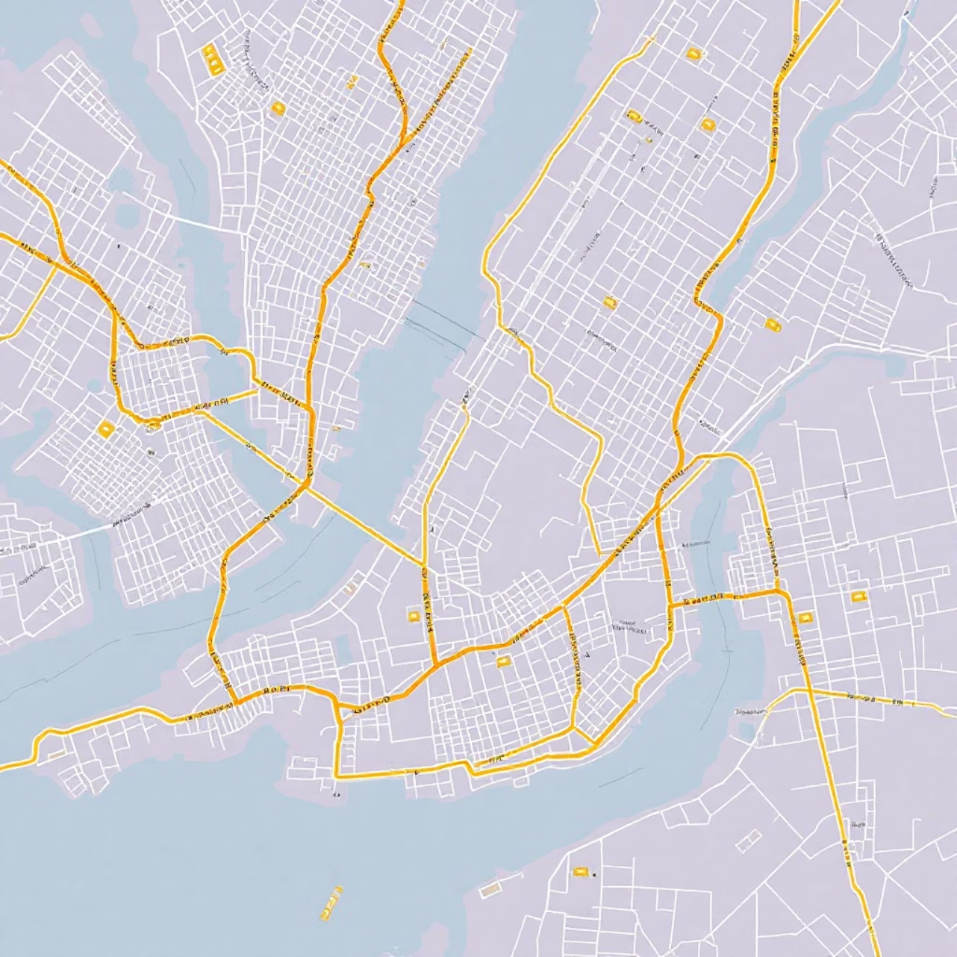

Dataset and Data Cleaning
The project leveraged a single month of NYC Yellow Taxi Trip Data (March 2016). Robust data cleaning was essential to ensure the validity and geographic relevance of the training data.
Invalid Trip Removal: Trips with passenger counts 0 or > 6 and zero-distance trips were filtered out.
Geographic Constraints: Trips outside the operational bounds of New York City ( latitude 40.5∘ to 41∘ and longitude −74.3∘ to −73.7∘) were excluded.
Final Working Dataset Size: 11,968,907 rows, ready for aggregation and modeling.

Slide 5



Feature Engineering: Capturing Spatio-Temporal Context
The success of the prediction service relied heavily on transforming raw pickup locations into a meaningful set of features for the ensemble models.
Spatial Discretization
Target Variable
Lagged Demand (Key Feature)
Pickup locations were binned into a 0.01° × 0.01° grid, approximating a 1 km² zone size, creating unique lat_bin and lon_bin features.
The target, demand_count, is the total number of trips originating from a specific spatial bin during a specific hour and weekday.
Three auto-regressive features—demand_lag_1h, 2h, and 3h—were engineered to capture the historical patterns of demand within the same grid cell.

Slide 6
Modeling & Validation Approach
We implemented multiple regression models and used time-series specific cross-validation to ensure model robustness against temporal shifts.
1
2
Model Types
Data Split & Metrics
Linear Regression (Baseline)
Temporal split: 80% for training, 20% for testing. Metrics used: RMSE, MAE, and R2 Score.
Random Forest Regressor
XGBoost Regressor (Primary Advanced Model)
3
4
Validation Strategy
Hyperparameter Tuning
Time Series Split Cross-Validation (TSCv, n_splits=5) was performed on the training set to accurately simulate real-world sequential prediction.
RandomizedSearchCV was applied to the Random Forest model to optimize performance and reduce overfitting.

Slide 7
Model Performance Comparison
Ensemble methods, particularly Random Forest and XGBoost, demonstrated vastly superior predictive accuracy compared to the baseline and pure time-series approaches.
Linear Regression (Baseline)
50.91
41.21
0.903
Random Forest Regressor
36.49
12.96
0.950
XGBoost Regressor
37.07
16.27
0.949
XGBoost (Extended with weather)
40.50
17.81
N/A
Note: Pure time-series models (ARIMA, LSTM aggregated hourly) showed significantly poorer R2 scores (0.030 and 0.681, respectively), confirming the necessity of the spatial context.

Slide 8
The Power of Ensemble and Lag Features
The exceptional performance of Random Forest and XGBoost models confirms that taxi demand is a non-linear, auto-regressive problem best handled by complex tree-based interactions.
Ensemble Superiority
R2 scores near 0.95 indicate that these models explain almost 95% of the variance in demand, far exceeding the Linear Regression baseline.
Non-Linearity Captured
The relationship between time, location, and demand history is non-linear; ensemble methods excel at capturing these complex interactions.
Critical Role of Lags
Lagged demand features effectively leverage the self-repeating nature of demand within each specific geographic zone.
External Data Impact
Simulated external features (weather) slightly degraded performance, suggesting their marginal value compared to historical demand signals.

Slide 9

Prescriptive Output: Top 10 High-Demand Zones
The final optimized XGBoost model was used to generate actionable recommendations by predicting average future demand across the NYC grid. This moves the project from prediction to prescription.
1
40.79
-73.98
707.53
2
40.79
-73.97
654.44
3
40.80
-73.97
462.93
4
40.80
-73.96
215.72
5
40.79
-73.95
207.82
...
...
...
...
10
40.83
-73.71
126.93

Slide 10








Conclusion & Future Directions
The XGBoost Regressor provides an optimal, highly accurate spatial-temporal demand forecast, enabling intelligent taxi dispatch and operational optimization.
Key Success
Refined External Data
High-accuracy forecasting (R2 ≈ 0.95) driven by effective feature engineering of spatial bins and lagged demand.
Incorporate actual minute-by-minute weather data (precipitation, temperature) and specific scheduled events.
Origin-Destination (OD) Modeling
Advanced Deep Learning
Explore Graph Neural Networks (GNNs) to model the dependencies between adjacent grid cells simultaneously.
Predict both pickup and drop-off counts to understand flow dynamics crucial for repositioning empty taxis.

